Slide 1
Internal migration and ageing in regional Australia
2 March 2022
Damien White
Executive Director – Centre for Population

Slide 2
The Centre for Population
Our vision
Strong Evidence. Deep Insights. Collaborative Approach.
Our
objectives
Enrich the evidence base
Inform strategic policy-making
Support the responsible Minister
Proactively engage with stakeholders
How we work
Identify and address data gaps
Undertake and commission research pieces
Inform national population policy
Identify emerging policy priorities
Engage with state, territory and local governments, academics, business and the general public to enrich the evidence base
What we deliver
Population Statement
The Statement is an annual overarching document capturing the population landscape in Australia including composition, distribution, and broader demographic trends.
National Population and Planning Framework
The Framework sets out how all levels of government will work together to better plan for Australia’s future population.
Population Plan
The Government will plan for the effects of population change by assessing the costs and benefits of change, incorporating state, territory and local government plans and mapping and analysing existing population data.

Slide 3
Regional areas have had their largest net gain on record
Internal migration between regions and capital cities, year ending, 2003 to 2021
Departures from capitals
above pre-COVID level
244,000 in past year
Capital city residents moving to regions outside capitals (RHS)
Outside capital city residents moving to capitals (RHS)
Net internal migration for regions outside capital cities (LHS)
Source: ABS Regional internal migration estimates, provisional, March 2021

Slide 4
Net migration to regional areas seems to have remained elevated throughout 2021
Net migration to regional areas - indexed, Regional Australia Institute’s Regional Movers Index
Source: Regional Australia Institute

Slide 5
Population growth has been higher in regional areas than capital cities during the pandemic
Population growth in capital cities and regional areas
Source: ABS, Regional population, 2019-20, Centre for Population projections

Slide 6
Age composition of internal migration will increase population ageing in regional areas
Migration rates by age for intrastate departures, capital cities and regional areas
Regional areas to capitals
Capitals to regional areas
Note: Departure rates excludes interstate moves
Source: Centre for Population projections using Wilson (2020)

Slide 7
Regional areas gain overall due to positive internal migration at older ages
Average annual projected levels of internal migration for regional areas, by age
Arrivals to regions
Net internal migration for regions
~37,000 total average annual net inflow to regions
Departures from regions
Note: Includes all regional arrivals and departures (intra- and inter-state moves)
Source: Centre for Population projections using Wilson (2020)

Slide 8
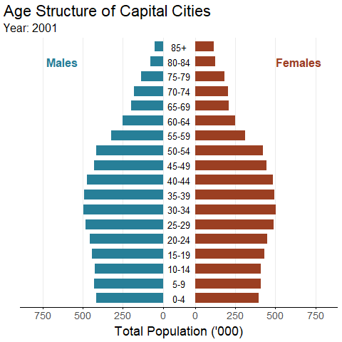
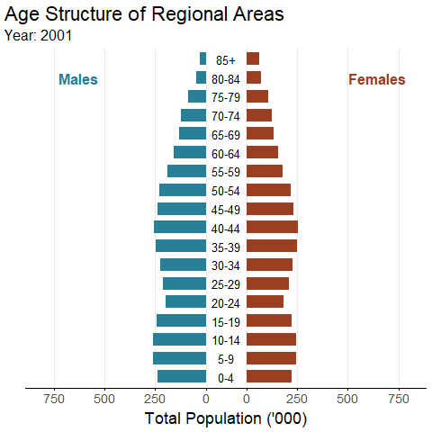
Regional areas have an older age structure than capital cities
Age structure, capital cities and regional areas, 2001 to 2032
Source: ABS, Regional population, 2019-20, Centre for Population projections

Slide 9
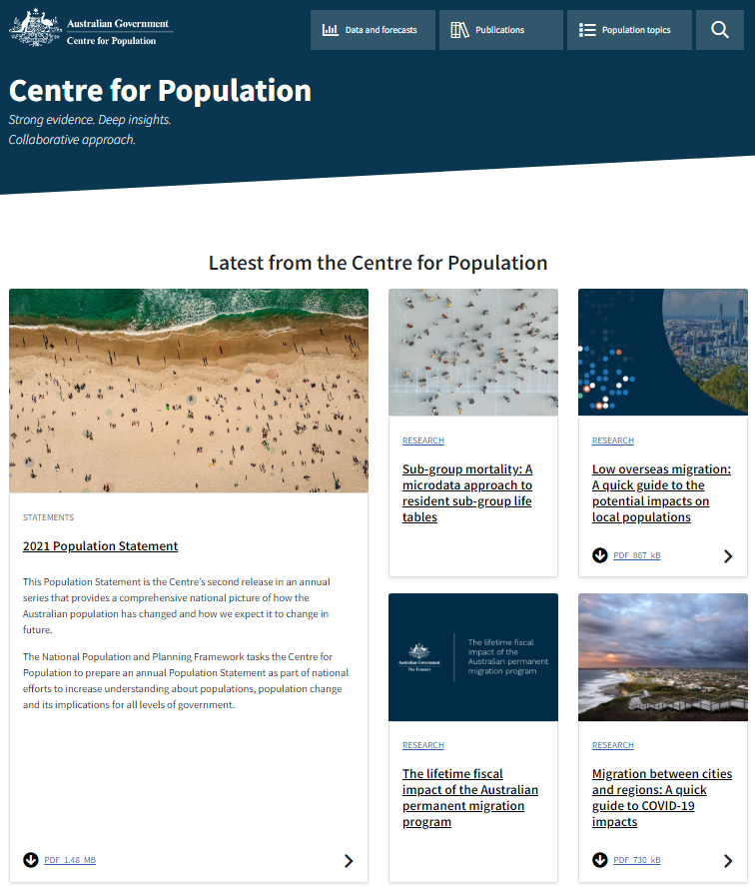
Centre for Population website has more information on regional migration
Strong evidence. Deep insights. Collaborative approach.
www.population.gov.au

